Slide 1
Chapter Three Routers
By Cheru H.

Slide 2
Router basic configuration
Hostname
No ip domain-lookup
Banner
Vty configuration
Console configuration
Enable secret
password encryption
Password minimum length
Description

Slide 3
Static routes
A router can learn about remote networks in one of two ways:
Manually - Remote networks are manually entered into the route table using static routes.
Dynamically - Remote routes are automatically learned using a dynamic routing protocol.

Slide 4
Why Use Static Routing?
Static routing provides some advantages over dynamic routing, including:
Static routes are not advertised over the network, resulting in better security.
Static routes use less bandwidth than dynamic routing protocols, no CPU cycles are used to calculate and communicate routes.
The path a static route uses to send data is known.

Slide 5
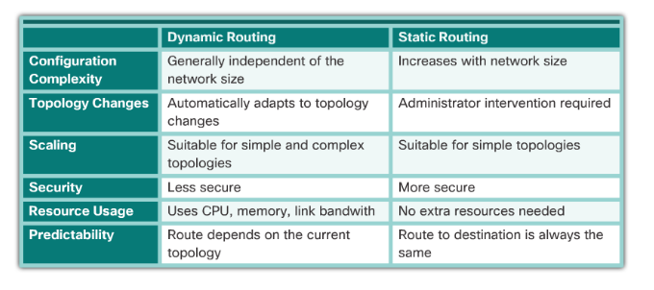

Slide 6
When to Use Static Routes
Static routing has three primary uses:
Providing ease of routing table maintenance in smaller networks.
Routing to and from stub networks. A stub network is a network accessed by a single route, and the router has no other neighbors.
Using a single default route to represent a path to any network that does not have a more specific match with another route in the routing table.

Slide 7
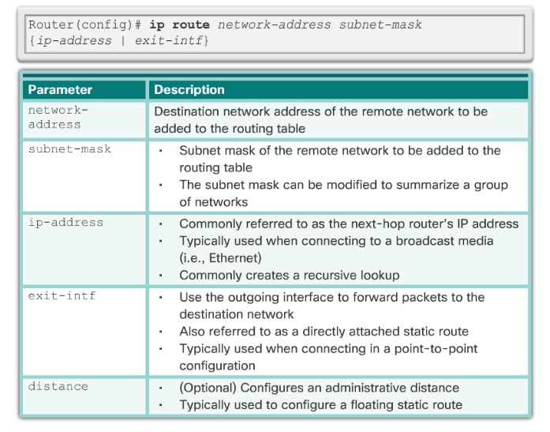

Slide 8
Default Static Route
A default static route is a route that matches all packets.
A default route identifies the gateway IP address to which the router sends all IP packets that it does not have a learned or static route.
A default static route is simply a static route with 0.0.0.0/0 as the destination IPv4 address.

Slide 9
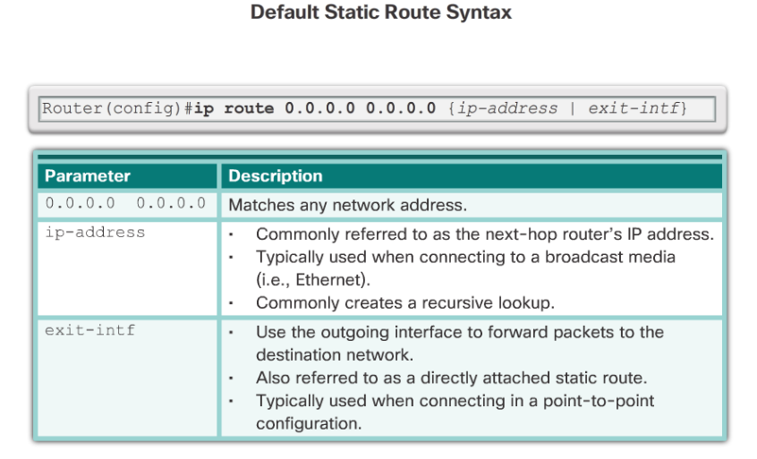

Slide 10
Dynamic Routing Protocols
Routing Protocols are used to facilitate the exchange of routing information between routers.
The purpose of dynamic routing protocols includes:
Discovery of remote networks
Maintaining up-to-date routing information
Choosing the best path to destination networks
Ability to find a new best path if the current path is no longer available

Slide 11
Dynamic Routing Protocols Components
Main components of dynamic routing protocols include:
Data structures - Routing protocols typically use tables or databases for its operations. This information is kept in RAM.
Routing protocol messages - Routing protocols use various types of messages to discover neighboring routers, exchange routing information, and other tasks to learn and maintain accurate information about the network.
Algorithm - Routing protocols use algorithms for facilitating routing information for best path determination.

Slide 12
Static Routing Uses
Networks typically use a combination of both static and dynamic routing.
Static routing has several primary uses:
Providing ease of routing table maintenance in smaller networks that are not expected to grow significantly.
Routing to and from a stub network. A network with only one default route out and no knowledge of any remote networks.
Accessing a single default router. This is used to represent a path to any network that does not have a match in the routing table.

Slide 13
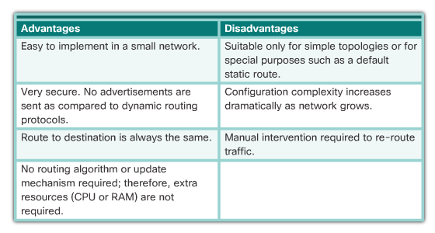
Static Routing Advantages and Disadvantages

Slide 14
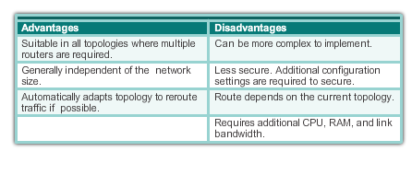
Dynamic Routing Advantages & Disadvantages

Slide 15
Types of routing protocols
Interior Gateway Protocols: Used for exchanging routing information between routers within an autonomous system (AS) (Intra-AS or intradomain). Ex: RIP, IGRP, OSPF, and EIGRP.
Exterior Gateway Protocols: Used for communication between autonomous systems (Inter-AS or interdomain). Out of the scope of CCNA. Ex: BGP.
Autonomous system (AS): is a collection of networks that is within the administration control of a company or organization that shares a common routing strategy.

Slide 16
Dynamic routing protocols
Distance-Vector Simple routing algorithm. Less effective and efficient compared to other classes of routing protocols. Targeted for small networks. Ex: RIP, IGRP.
Link-State Complex routing algorithm. Frequently used in large and complex networks. Ex: OSPF.

Slide 17
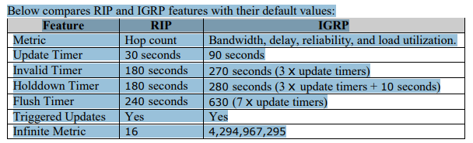
Example

Slide 18
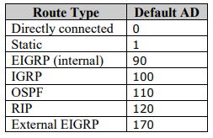
Default administrative distance values:

Slide 19
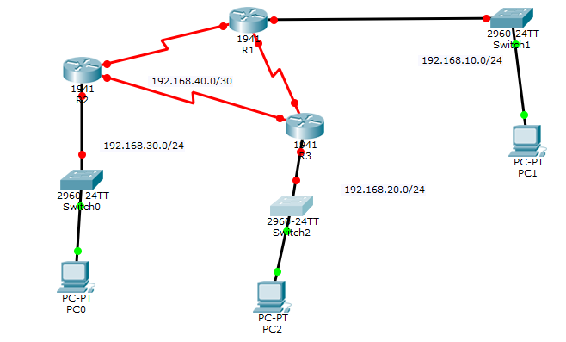
Implementation
R3
R1
R2

Slide 20
Configure
Static Routing Configuration
Default Routing Configuration
RIP Configuration

Slide 21
Static routing configuration
R1(config)#ip route 192.168.10.0 255.255.255.0 192.168.40.2 R1(config)#ip route 192.168.40.0 255.255.255.252 192.168.40.2 R1(config)#ip route 192.168.20.0 255.255.255.0 192.168.40.6

Slide 22
Default routing configuration
R1(config)#no ip route 192.168.10.0 255.255.255.0 192.168.40.2 R1(config)#no ip route 192.168.40.0 255.255.255.252 192.168.40.2 R1(config)#no ip route 192.168.20.0 255.255.255.0 192.168.40.6
R1(config)#ip route 0.0.0.0 0.0.0.0 192.168.40.2

Slide 23
RIP configuration
R1(config)#no ip route 0.0.0.0 0.0.0.0 192.168.40.2
R1(config)#router rip
R1(config-router)#network 192.168.30.0
R1(config-router)#network 192.168.40.4
R1(config-router)#network 192.168.40.0

